Slide 1
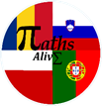
Project name: MATHS ALIVE
KA229 - Cooperation for Innovation and the Exchange of Good Practices

Slide 2
SLOVENIA
in shapes and numbers

Slide 3
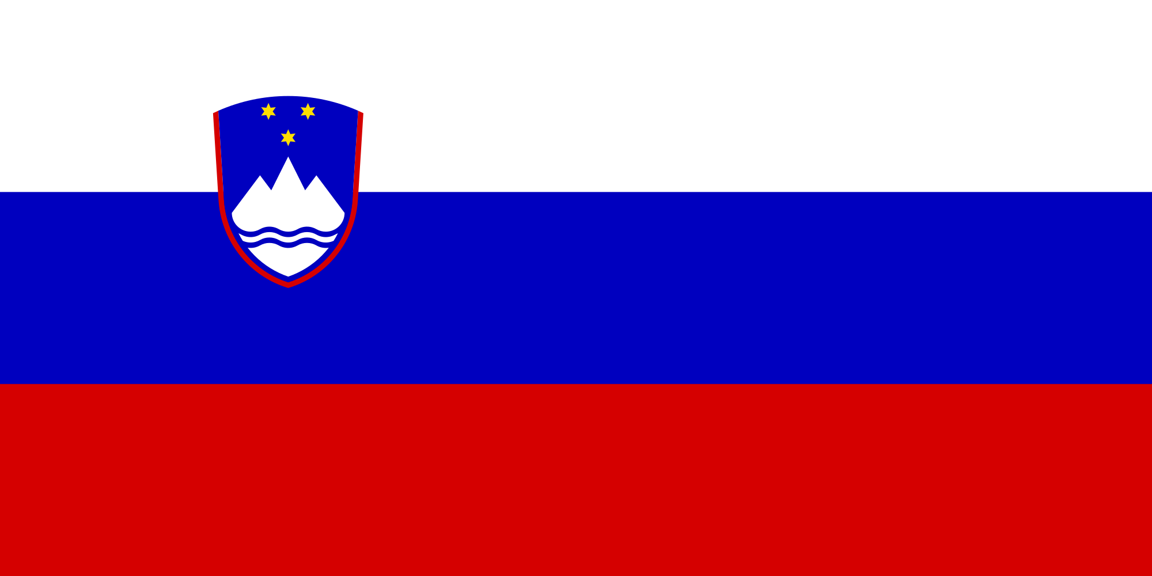
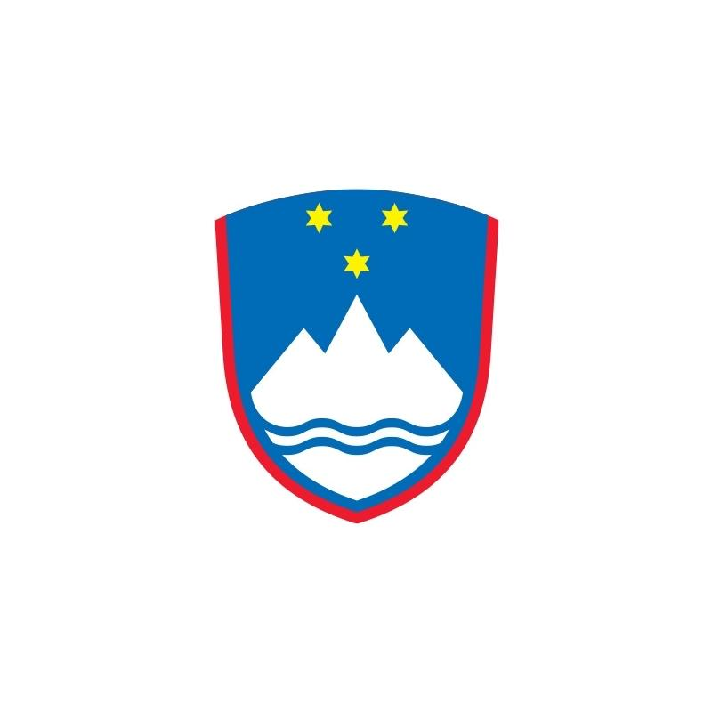
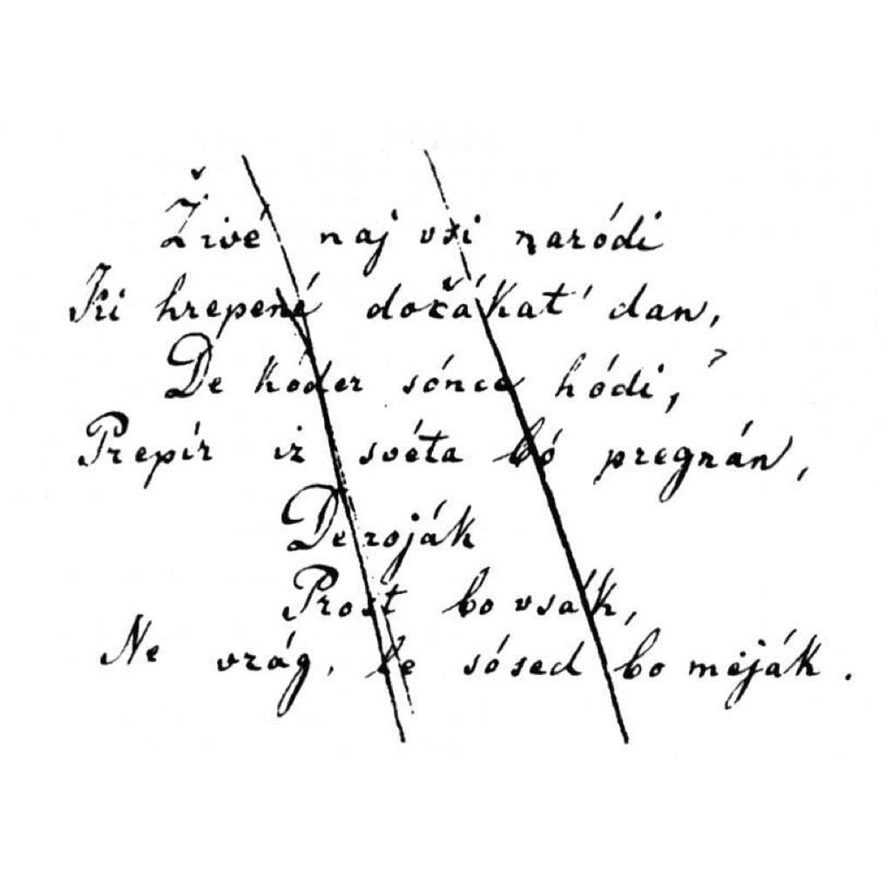
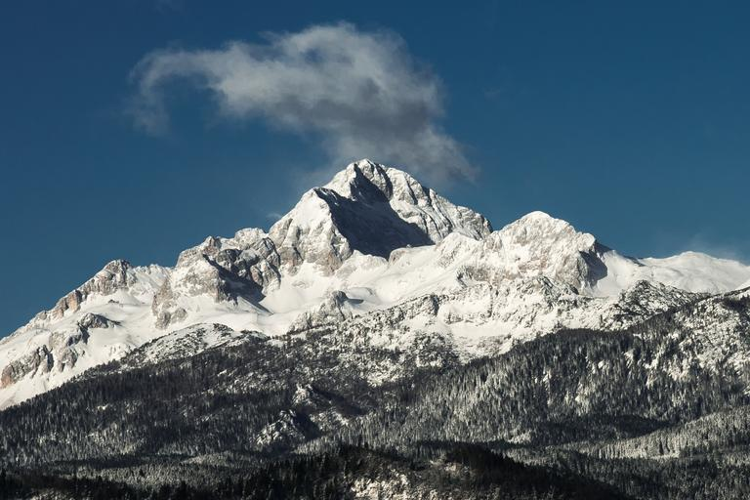
NATIONAL SYMBOLS
FLAG: 3 colors
COAT OF ARMS: 1 symmetry, 3 stars
STARS: six-pointed
NATIONAL ANTHEM: Zdravljica, 28 words
MOUNTAIN: Triglav, 2864 m

Slide 4
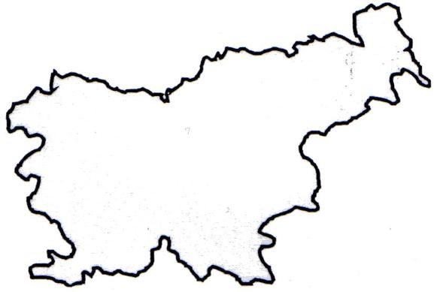
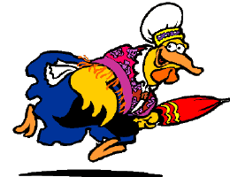
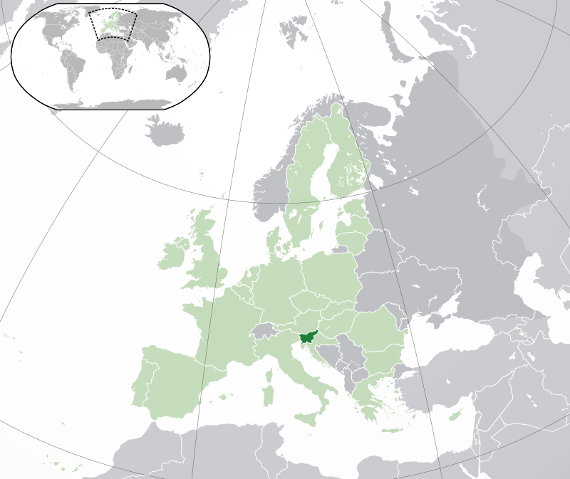
BOARD AND SURFACE
SHAPE: Chicken
LENGTH: 1.382 km
SURFACE: 20,273 km²
COAST LINE: 43157 m
Slovenia Covers Less Than 0.004% Of The Earth’s Surface

Slide 5
POPULATION
POPULATION: 2.084 million
MALE: 1.041.965
FEMALE: 1.042.336
83% Slovenes
73.2% Catholics

Slide 6
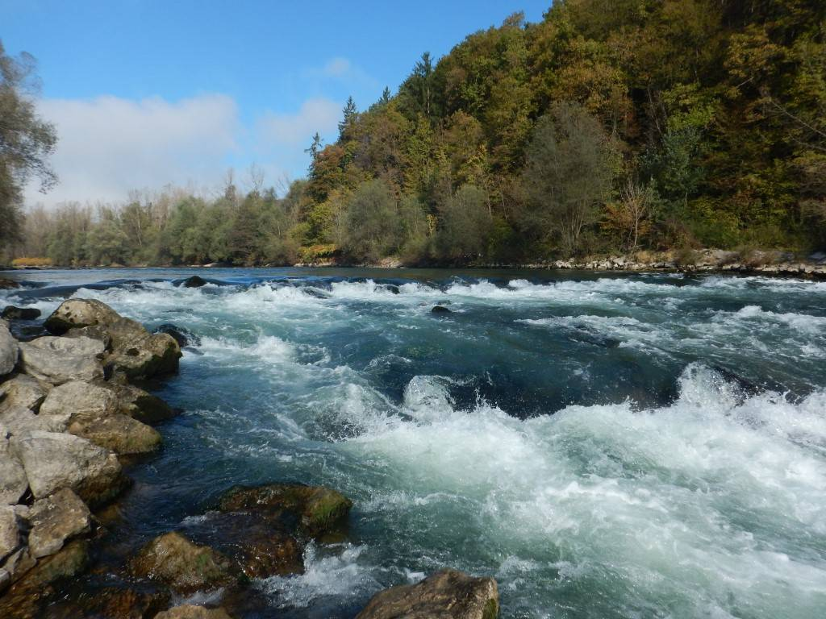
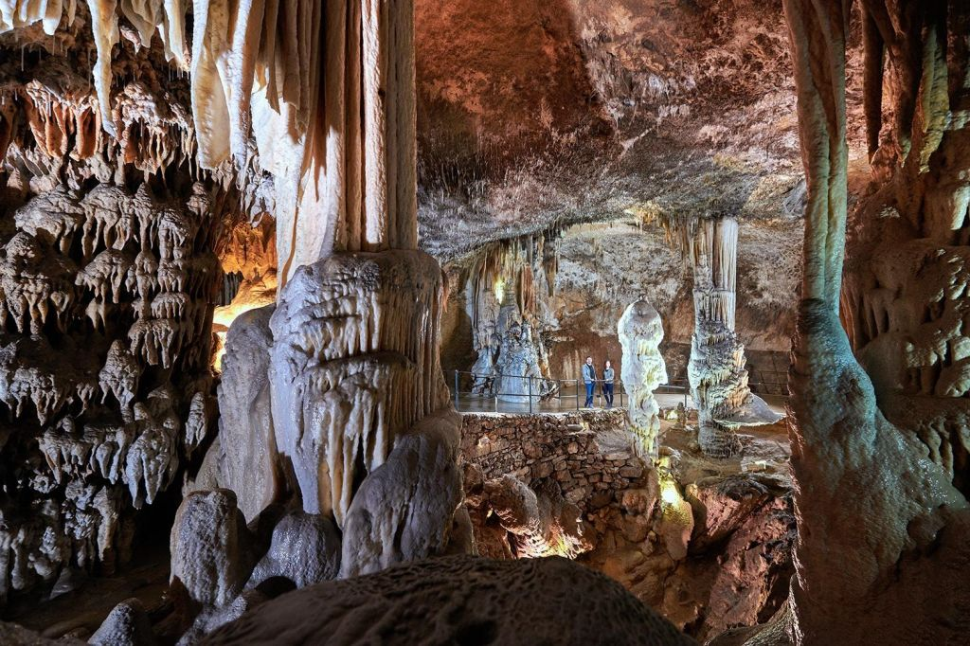
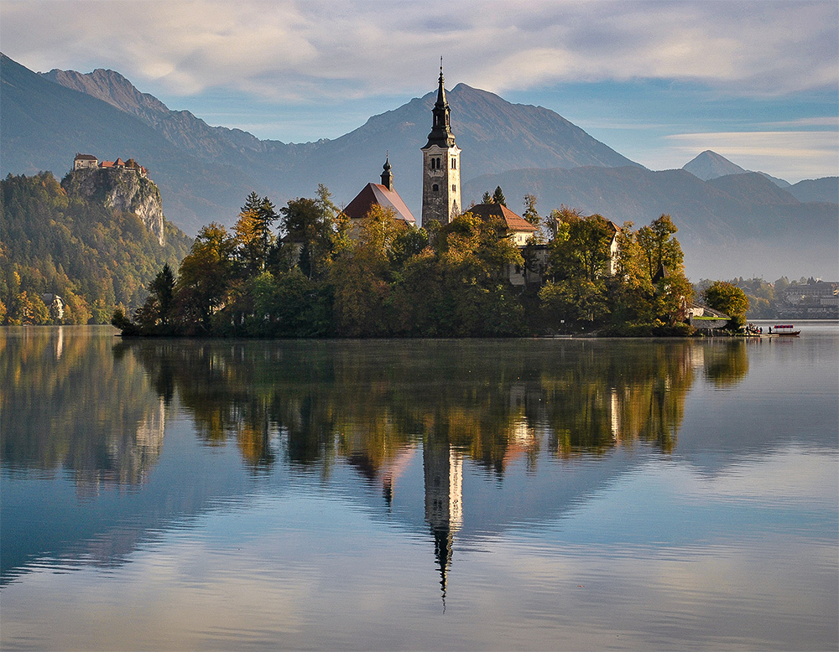
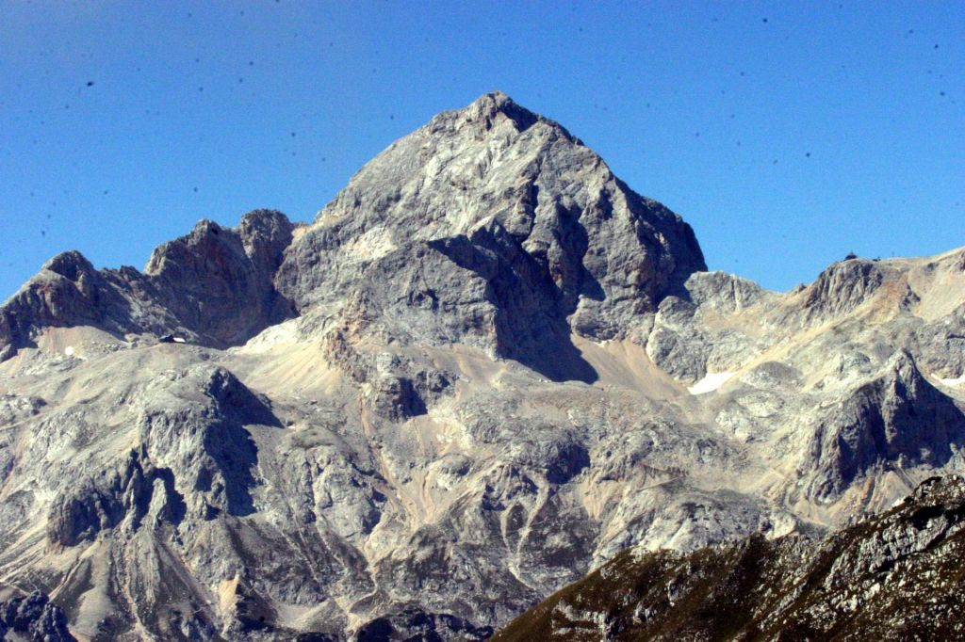
NATURE
THE LONGEST RIVER: Sava, 947 km (only 23% in Slovenia)
THE HIGHEST WATERFALL: Kloma, 128 m
LAKES: around 1300
There Are More Than 10000 Caves
More Than 61% Of The Total Land Area Is Covered In Forest

Slide 7
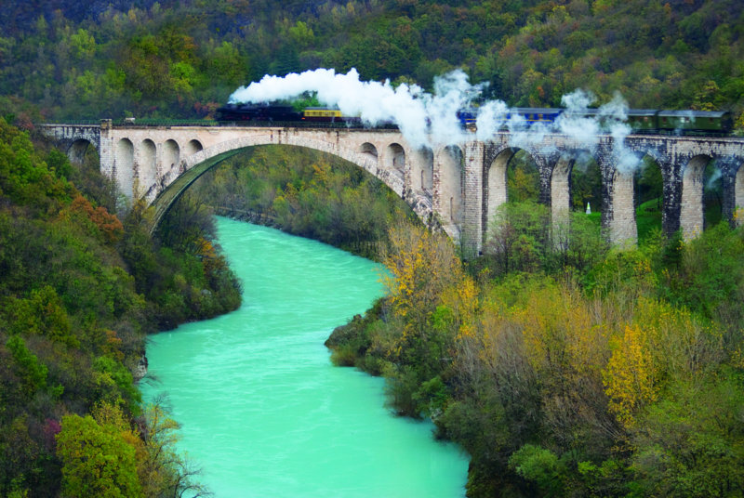
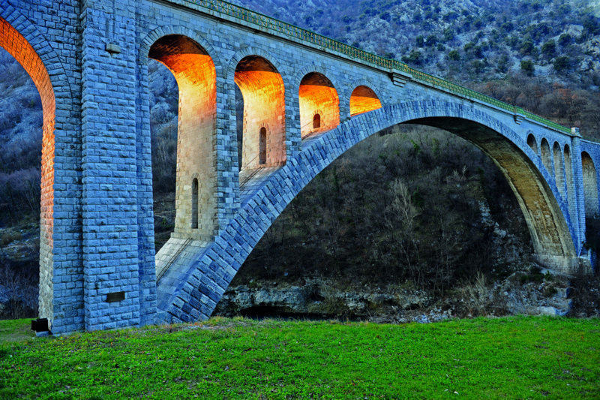
THE SOLKAN BRIDGE
The Solkan Bridge is the world’s longest stone-arch bridge railway
It was built between 1900 and 1906
It was demolished in first world war and then rebuild in 1927
Features 4533 stone blocks that stretch 220 meters.

Slide 8
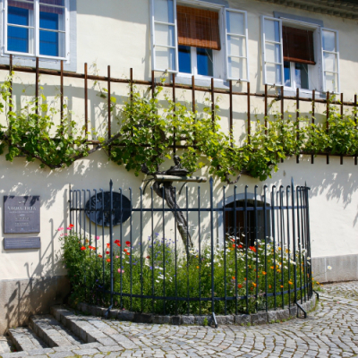
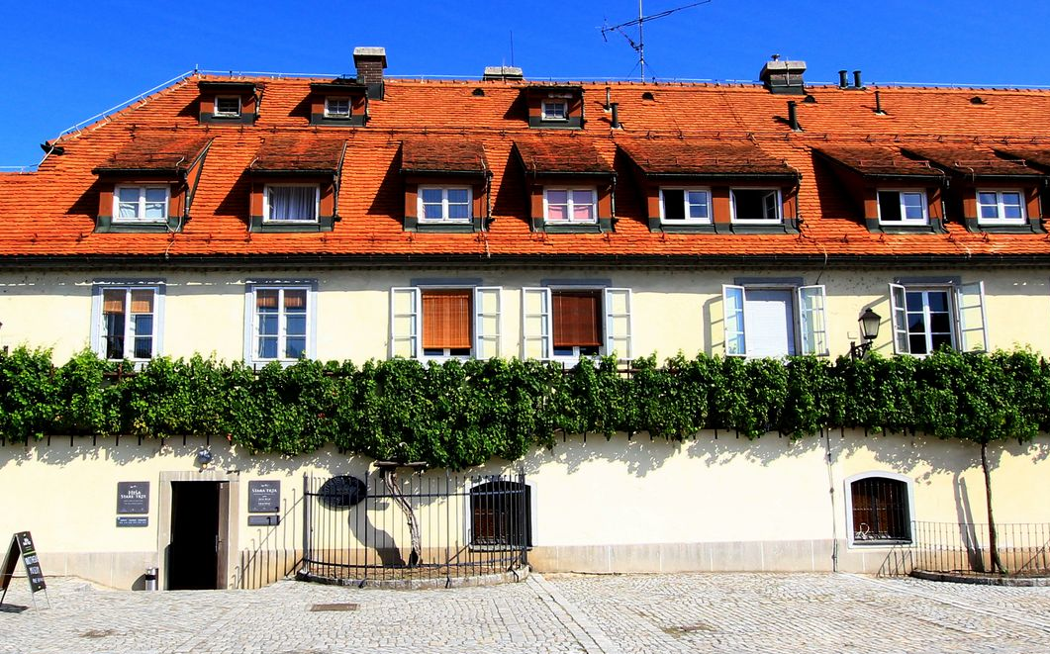
THE OLDEST VINE
In Maribor, you can also see the oldest vine in the world that still produces grapes. The vine is estimated to be around 400 years old.

Slide 9
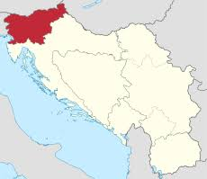
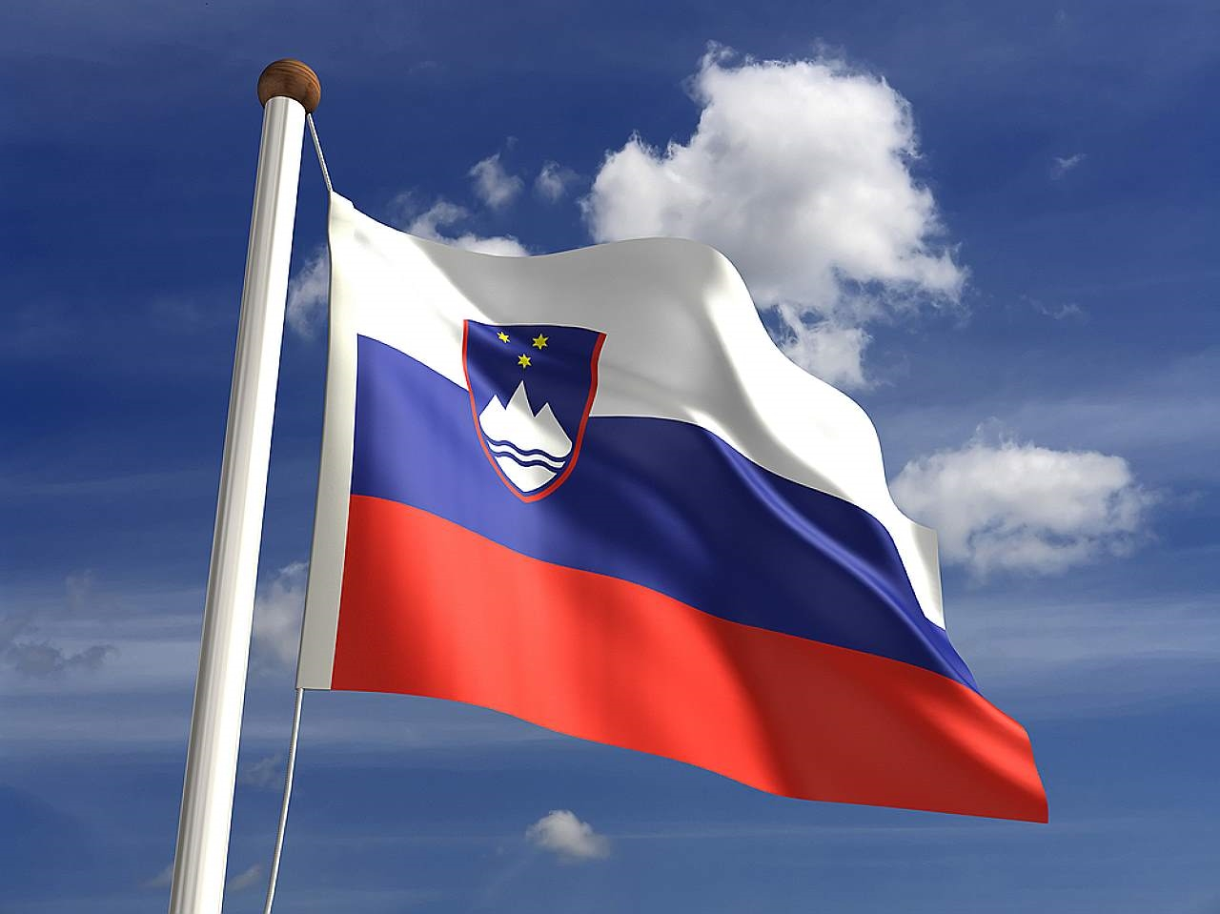
HISTORY
On 23 December 1990, more than 88% of the electorate voted for a sovereign and independent Slovenia
25 June 1991, Slovenia became independent
On 27 June in the early morning begann the Ten-Day War
The European Union recognised Slovenia as an independent state on 15 January 1992, and the United Nations accepted it as a member on 22 May 1992.
Slovenia joined the European Union on 1 May 2004

Slide 10
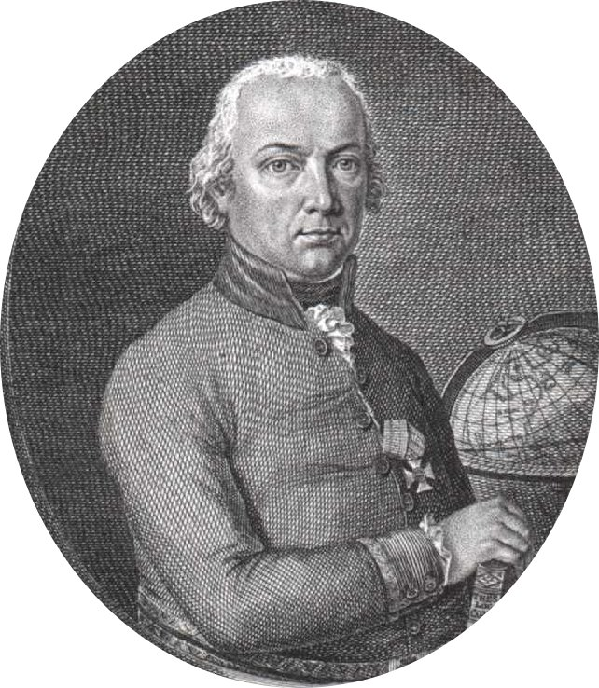
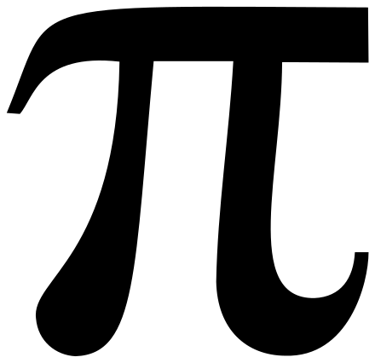
JURIJ VEGA
A Slovene mathematician, physicist, surveyor, meteorologist and artillery officer
His major work was Thesaurus Logarithmorum Completus (Treasury of all Logarithms) that was first published 1794 in Leipzig
On August 20, 1789 - pi to 140 places, the first 126 were correct.
Vega retained his record 52 years until 1841
His method is mentioned still today

Slide 11
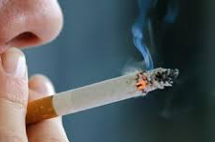
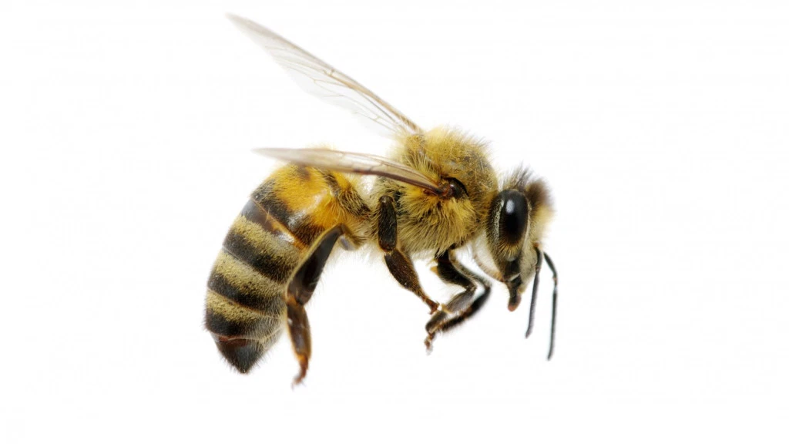
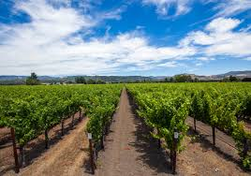
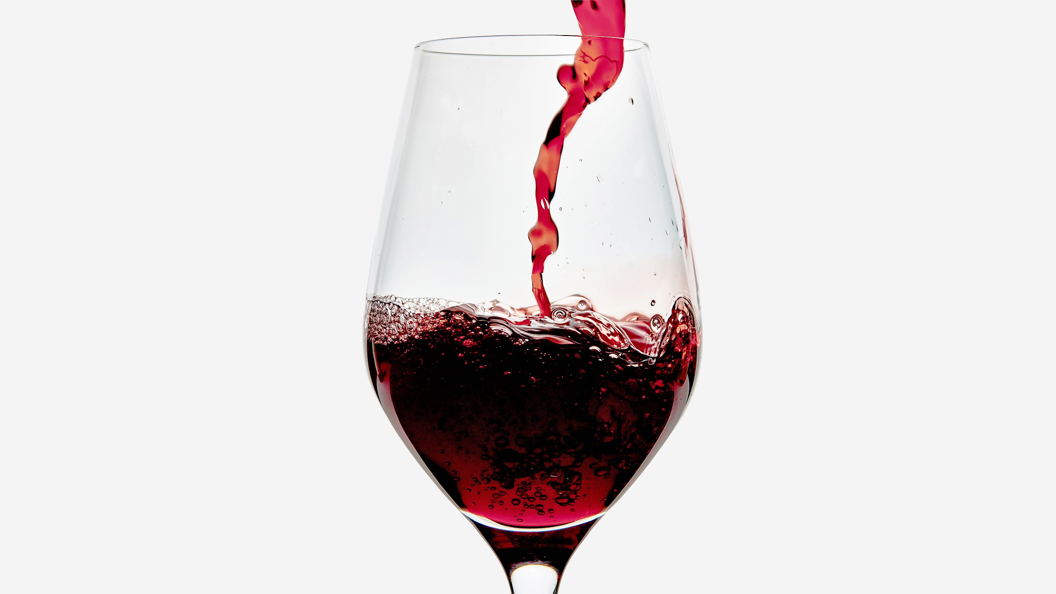
INTERESTING FACTS
1 in 20 people keep bees
53,6% of Slovenia is protected land
One of the 10 tallest countries on the planet (a typical male measures 1.803m) and one of the 10 most elderly (its residents are 43.5 years old, on average).
They are also the world’s sixth biggest smokers, and the sixth biggest consumers, per capita, of wine.
There’s a vineyard for every 70 people

Slide 12
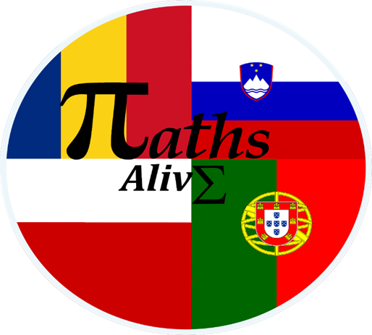
“The European Commission support for the production of this publication does not constitute an endorsement of the contents which reflects the views only of the authors, and the National Agency and Commission cannot be held responsible for any use which may be made of the information contained therein”

