Slide 1
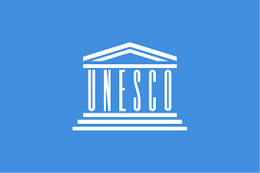

Slide 2
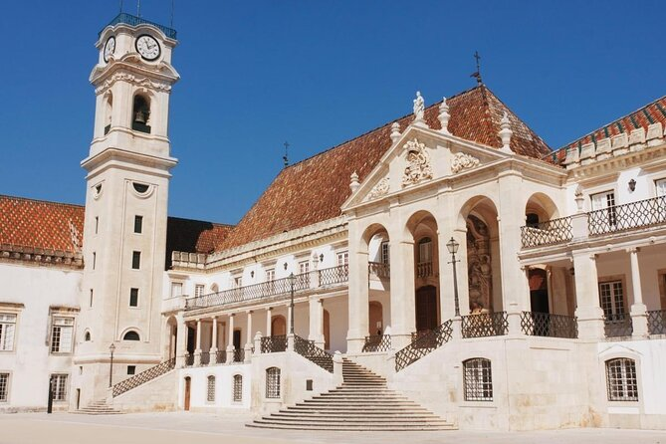
Coimbra University
The university is among the oldest universities in continuous operation in the world, the oldest in Portugal, and played an influential role in the development of higher education in the Portuguese-speaking world.
In 2013, UNESCO declared the university a World Heritage Site, noting its architecture, unique culture and traditions, and historical role.

Slide 3
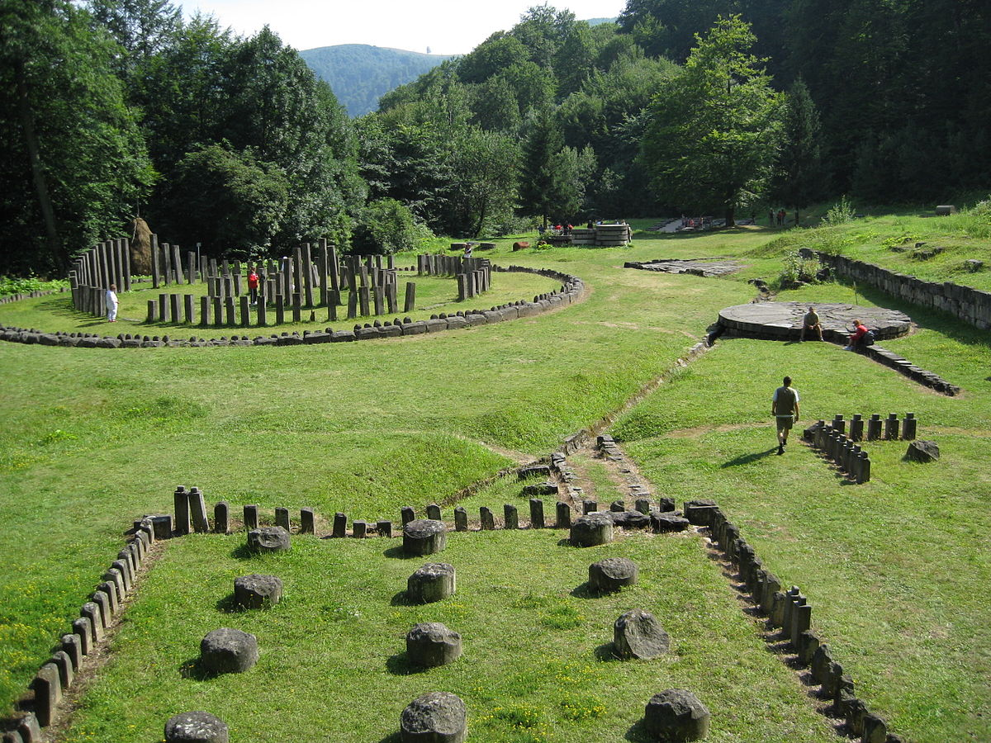
Dacian Fortresses
the six Dacian Fortresses of the Orăștie Mountains in Romania were created in the 1st centuries BC and AD as protection against Roman conquest, and played an important role during the Roman-Dacian wars.
The six fortresses were designated as a UNESCO World Heritage Site in 1999.

Slide 4
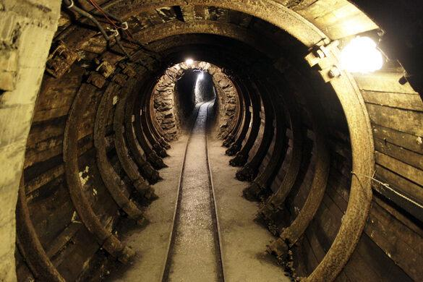
IDRIA MERCURY MINES
Heritage of Mercury. Almadén and Idrija is a joint UNESCO World Heritage site in Almadén, Castile-La Mancha, Spain, and Idrija, Slovenia. The property encompasses two mercury mining sites. In Almadén mercury has been extracted since Antiquity, while in Idrija it was first found in 1490
It was the second largest producer of this ore in the world.

Slide 5
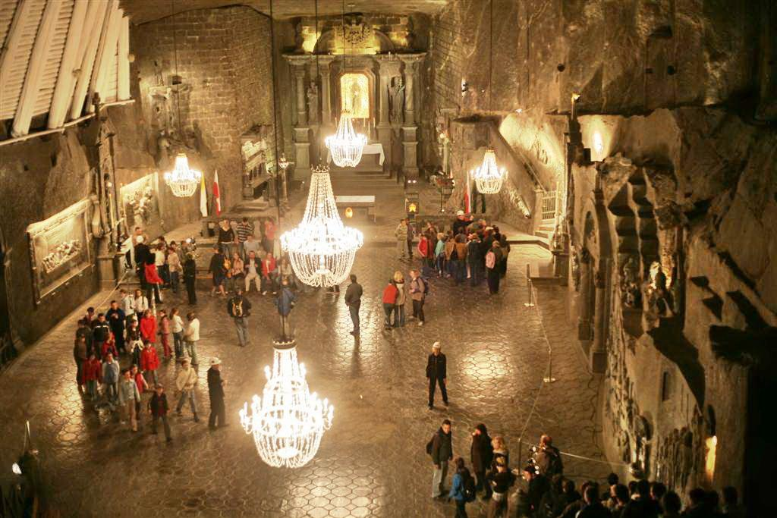
Wieliczka Salt Mine
The Wieliczka salt mine, excavated from the 13th century, produced table salt continuously until 2007, as one of the world's oldest operating salt mines.
The Wieliczka Salt Mine is now an official Polish Historic Monument (Pomnik Historii) and a UNESCO World Heritage Site.

Slide 6
Thanks for your attention!
Ema Cerne – Slovenia
Boglarka Vargyas – Romania
Blanka Buczkowicz and Igor Chudzikiewicz- Poland
Jorge Nascimento – Portugal

