Slide 1
Unesco sites
.

Slide 2
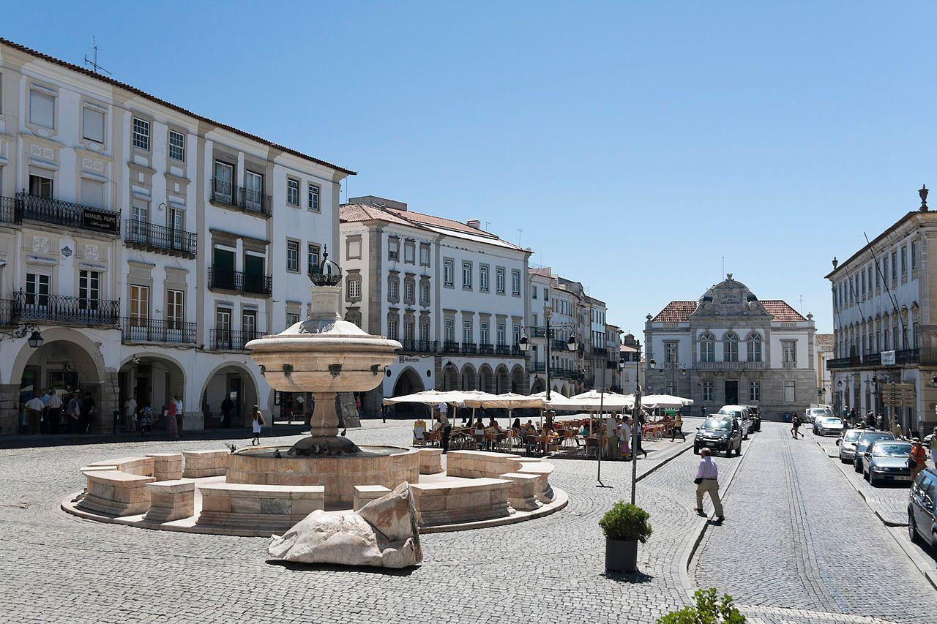
Old Town of Evora
Évora District is located in Alentejo, in southern Portugal.
The district capital is the city of Évora.
Évora is a UNESCO World Heritage Site.

Slide 3
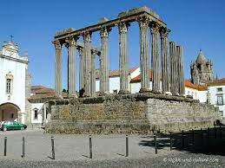
Old Town of Evora
In Evora, there is an importante roman monument, which is The Diana Temple.

Slide 4
Horezu Monastery

Slide 5
Horezu Monastery
It was founded in 1690
It is considered to be a masterpiece of "Brâncovenesc style", known for its architectural purity and balance, the richness of its sculpted detail, its treatment of religious compositions, its votive portraits, and its painted decorative works.
Length :32 m ,Height (max):14 m

Slide 6
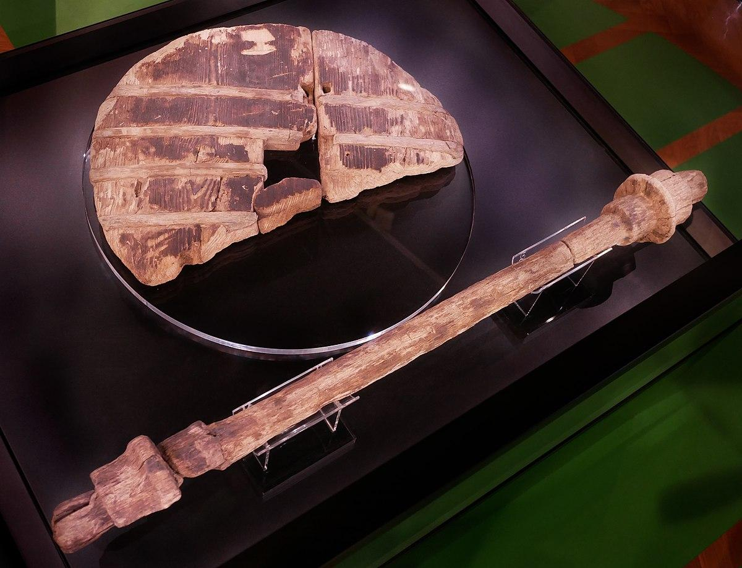
Prehistoric stilted settlements

Slide 7
Prehistoric stilted settlements
Location: the Alps
Built from 5000 to 500 BC, at the edges of lakes, rivers or wetlands
Until now they have found 111 of these settlements
Most important archeological find in Slovenian settlements: a wooden wheel

Slide 8
Wooden Church in Blizne
A Gothic, wooden church located in the village of Blizne from the fifteenth-century, which together with different churches is designated as part of the UNESCO Wooden Churches of Southern Lesser Poland.

Slide 9
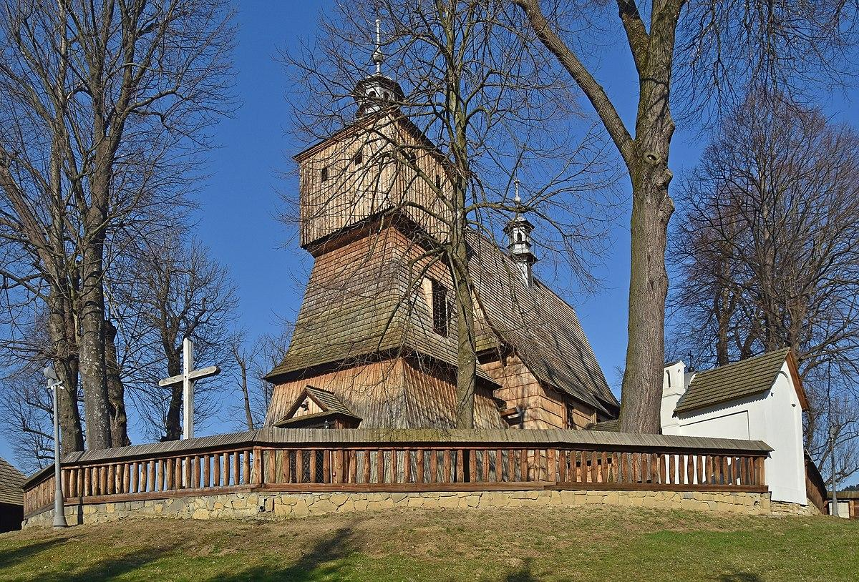
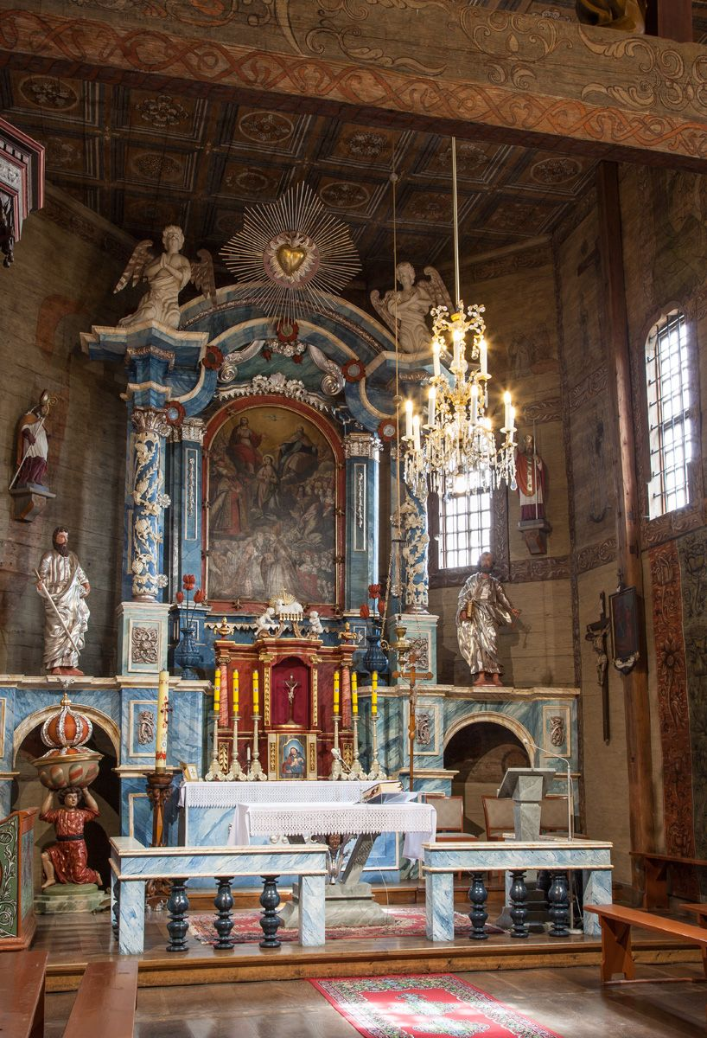

Slide 10
Thank you for your attention
CATARINA MOREIRA, PORTUGAL
TAMAS ZSIGMOND, ROMANIA
METOD FERJANČIČ, SLOVENIA
MARTYNA JAJKO, POLAND
OLIWIA ANKOWSKA, POLAND

