Slide 1
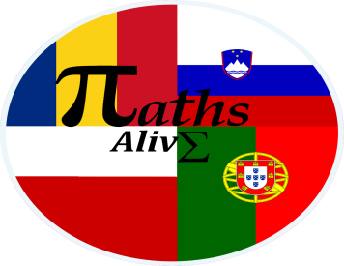
Unesco Sites
“The European Commission support for the production of this publication does not constitute an endorsement of the contents which reflects the views only of the authors, and the National Agency and Commission cannot be held responsible for any use which may be made of the information contained therein”

Slide 2
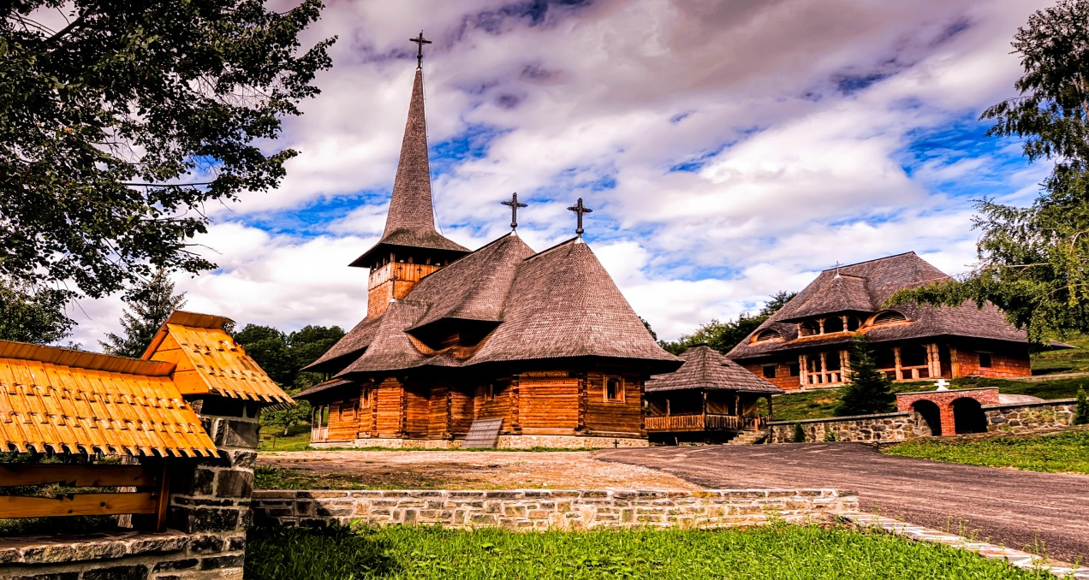
Wooden Ortodox churches of Maramureș
In the Maramureș region of Romania are a group of almost one hundred wooden Orthodox churches.

Slide 3
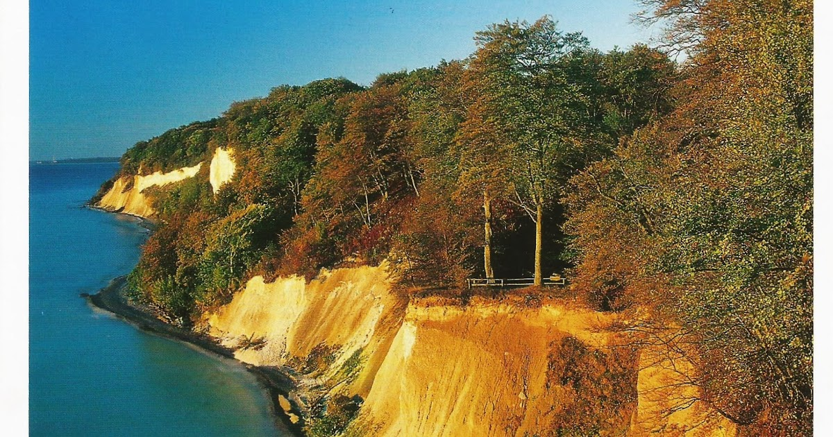
Beech Forests of the Carpathians
The area includes two national parks, and some habitat controlled areas in Slovenia.

Slide 4
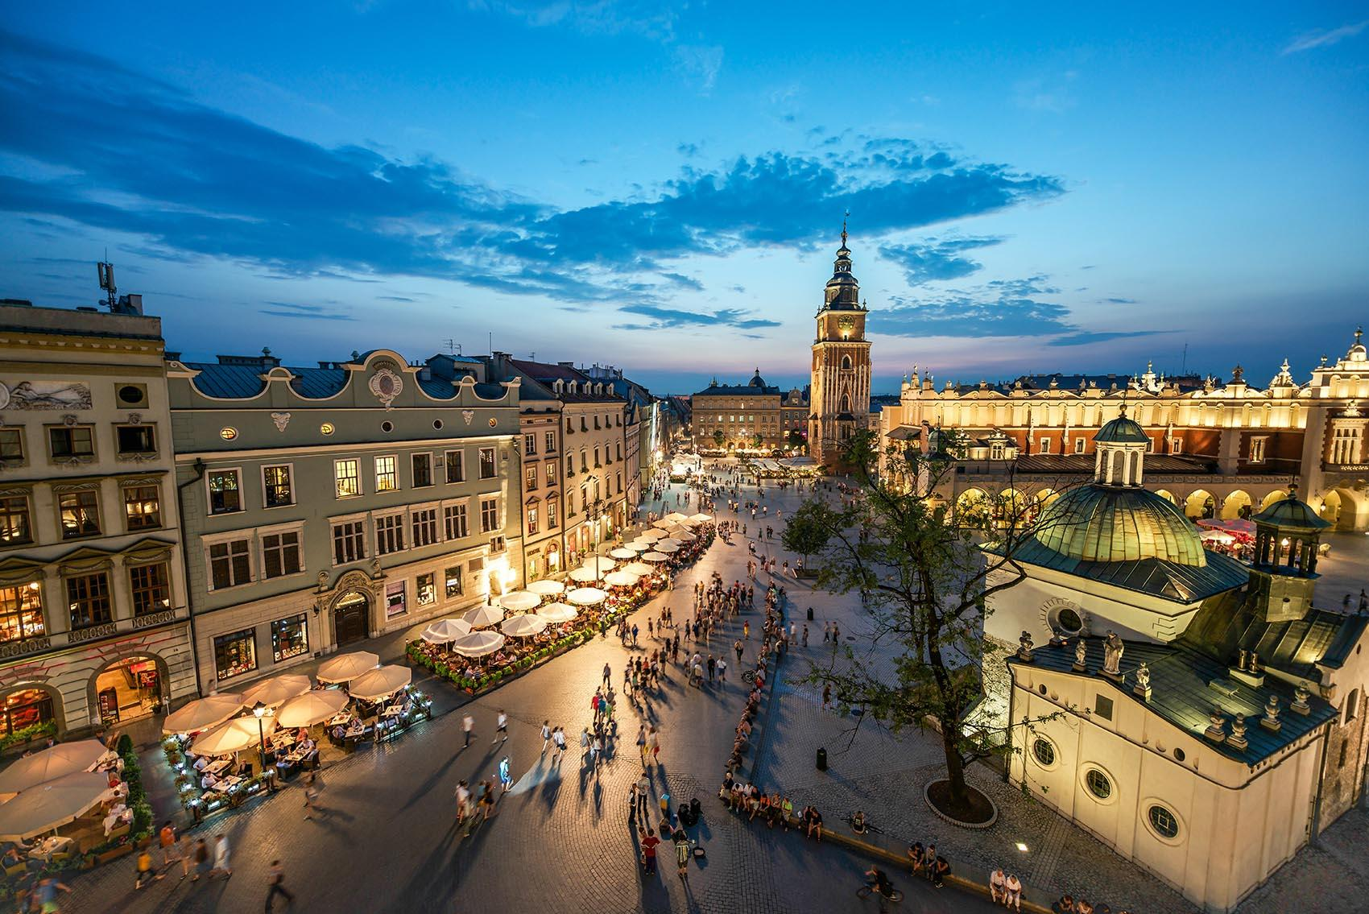
Old City of Cracow
It is the historic central district of Kraków, Poland. It is one of the most famous old districts in Poland today.

Slide 5
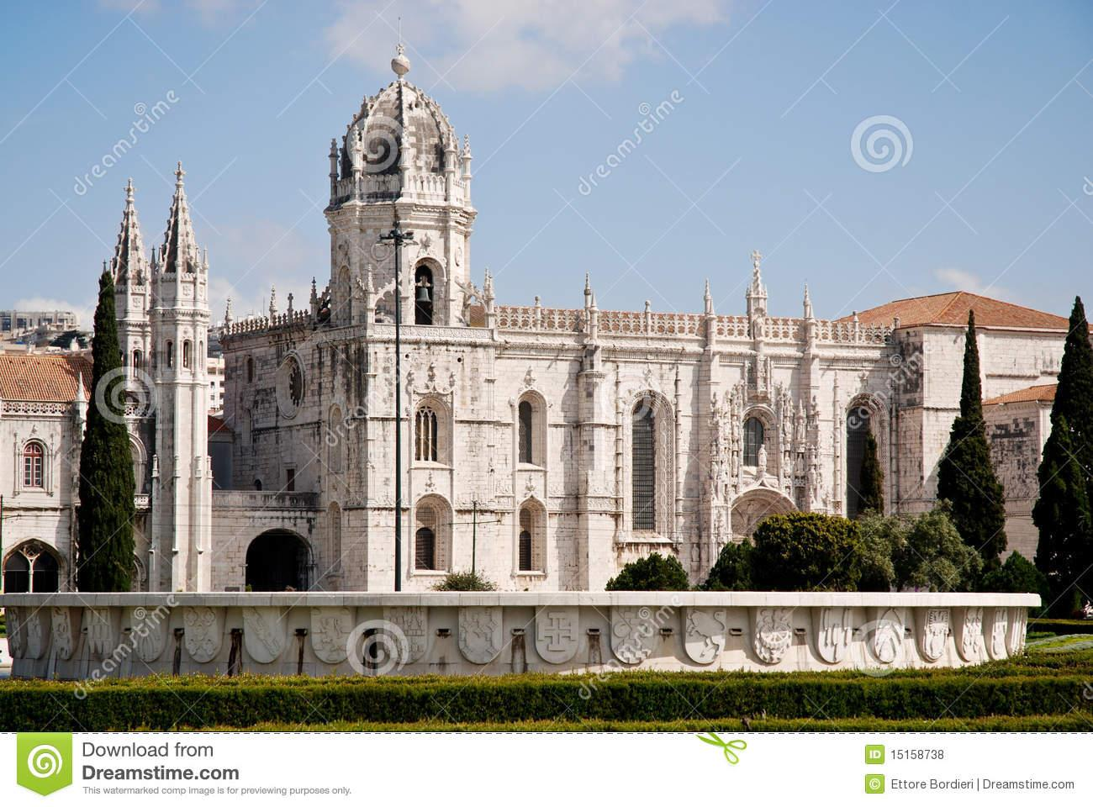
Hieronymites Monastery
The monastery is one of the most prominent examples of the Portuguese Late Gothic style of architecture in Lisbon.

Slide 6
Thank you for your attention!
By: Wiktor Herbut – Poland
Martyna Pająk – Poland
Neza Lemut – Slovenia
Martyna Pietryka- Poland
Gergo Szasz – Romania

