Slide 1
Stages of creating the logo of the project!
“The European Commission support for the production of this publication does not constitute an endorsement of the contents which reflects the views only of the authors, and the National Agency and Commission cannot be held responsible for any use which may be made of the information contained therein”

Slide 2
Romania – our coordinator

Slide 3
Slovenia – our patner

Slide 4
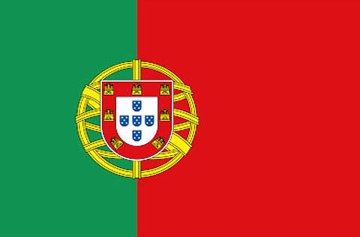
Portugal – our partner

Slide 5
… and we – the Poles

Slide 6
Πaths Aliv∑

Slide 7
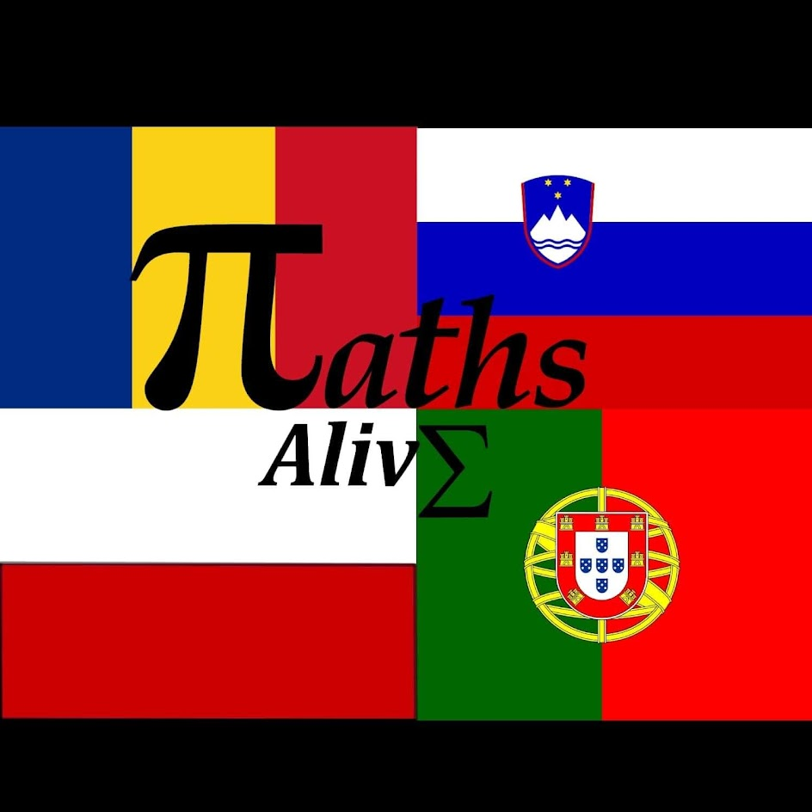
The final logo of
‘Maths Alive’ project ☺

Slide 8
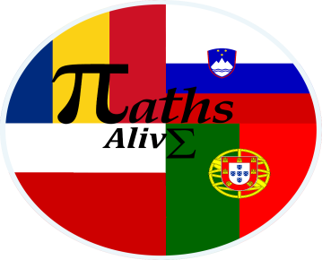
Hello! My name’s Kornelka. I am a student of Zespół Szkół Number 1 in Przysietnica. I am also the author of the logo of our first project. It is me……working on the logo project ! Thank you…………..

